Slide 1

Exploratory Data Analysis on FX Data
STELLA TAN

Slide 2







Slide 3
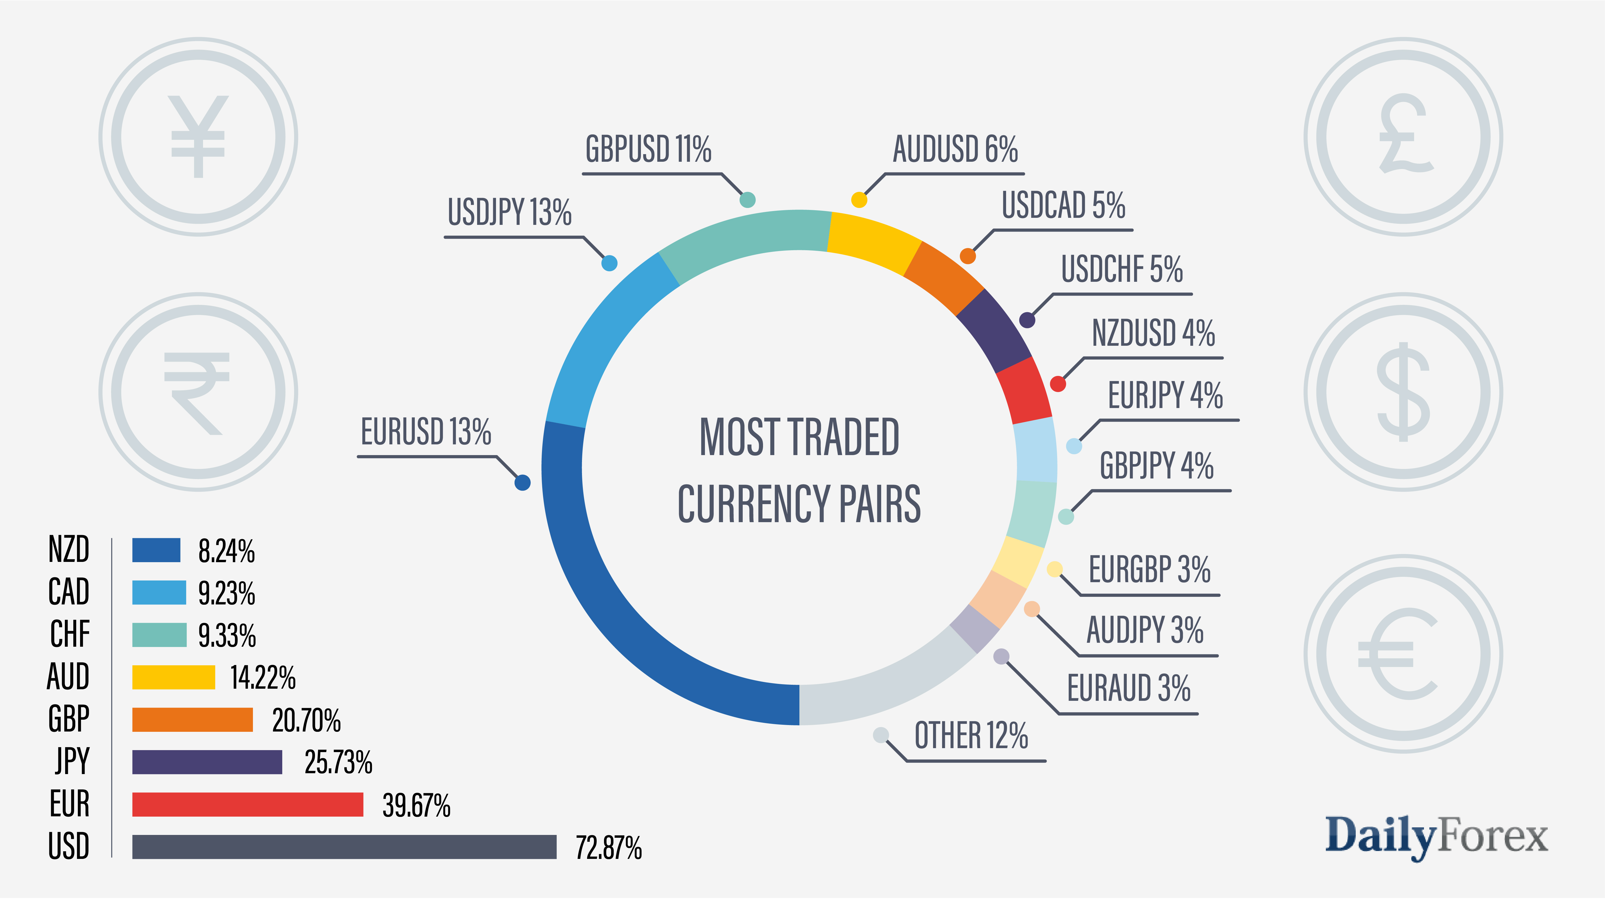

Slide 4
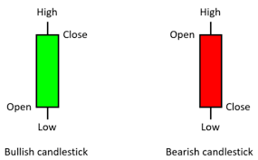

DATA SETS
1min candle data from Dukascopy downloaded in CSV format
Currency Pairs are: AUDUSD, EURUSD, GBPUSD, NZDUSD, USDJPY, USDSGD, USDCNH, XAUUSD, and 4 crosses - AUDJPY, EURJPY, GBPJPY, EURAUD
Gmt time | Open | High | Low | Close | Volume
02.01.2020 00:00:00.000 | 0.70188 | 0.70191 | 0.70168 | 0.70169 | 85.98
02.01.2020 00:01:00.000 | 0.70169 | 0.70182 | 0.70164 | 0.70165 | 91.02
02.01.2020 00:02:00.000 | 0.70167 | 0.70177 | 0.70167 | 0.70168 | 72.58
02.01.2020 00:03:00.000 | 0.70168 | 0.70175 | 0.70158 | 0.70172 | 79.82
02.01.2020 00:04:00.000 | 0.70173 | 0.7018 | 0.70169 | 0.70177 | 37.82
02.01.2020 00:05:00.000 | 0.70177 | 0.70177 | 0.70164 | 0.70169 | 75.51
02.01.2020 00:06:00.000 | 0.70169 | 0.70175 | 0.70164 | 0.70174 | 107.83
02.01.2020 00:07:00.000 | 0.70175 | 0.7019 | 0.70175 | 0.70185 | 111.15

Slide 5



CHALLENGES
Original data set using tick data had 54 million rows per currency pairs. Time taken to run the code was FOREVER. PC crashed even after breaking down the code by batches to run.
The final data set of 1min ticks used had 550k rows and included weekend data (price was constant for 2 days worth of data). How to remove them? Format of the date needs to be changed
1min data set also saw the laptop stalling when plotting charts as it had 370k rows, so had to resample to 5 min dataset which was also abt 80-100k rows of data
- Merging the columns we want into a large data frame
Making sense of the insights

Slide 6

Data Analysis
Based on the most traded pairs of currencies, to look at 8 straight usd pairs of currencies – AUDUSD, EURUSD, GBPUSD, NZDUSD, USDJPY, USDSGD, USDCNH, XAUUSD, and 4 crosses - AUDJPY, EURJPY, GBPJPY, EURAUD
Calculate the SMA20, SMA50, and SMA200 of the currency pairs based on daily closing prices and a preferred period . **Moving averages work when a lot of traders use and act on their signals, so we try to stick to popular ones
To come up with signals when to buy or sell based on SMA. Show a graph of the signals using sample data set in line chart format.
To study the correlation among the straight usd pairs using heatmaps, correlation chart and regression plot (Seaborn).
To check if multiplication of straight usd pairs, always give the same value as the 4 crosses.

Slide 7

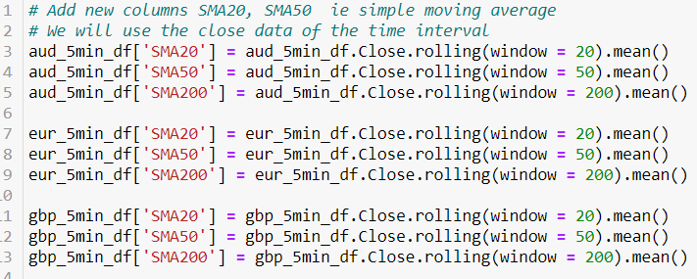
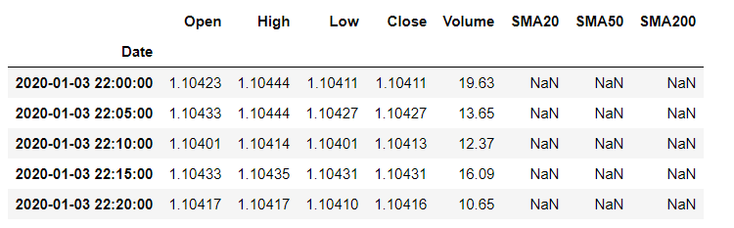
Simple Moving Average Strategy
Calculate and add new columns for SMA20, SMA50 and SMA200 in dataframe

Slide 8
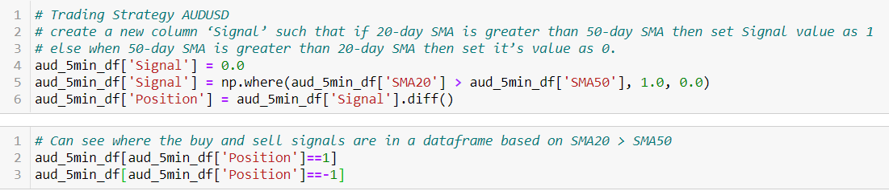
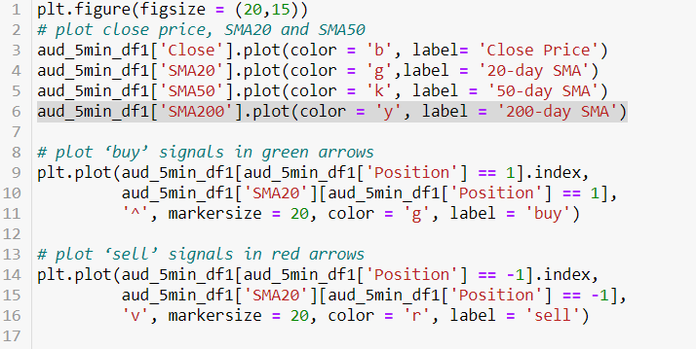
Simple Moving Average Strategy
Using a strategy SMA20 > SMA50 => BUY and vice versa
Plot the chart. Use a sample of 1500 data points for easier visualisation

Slide 9

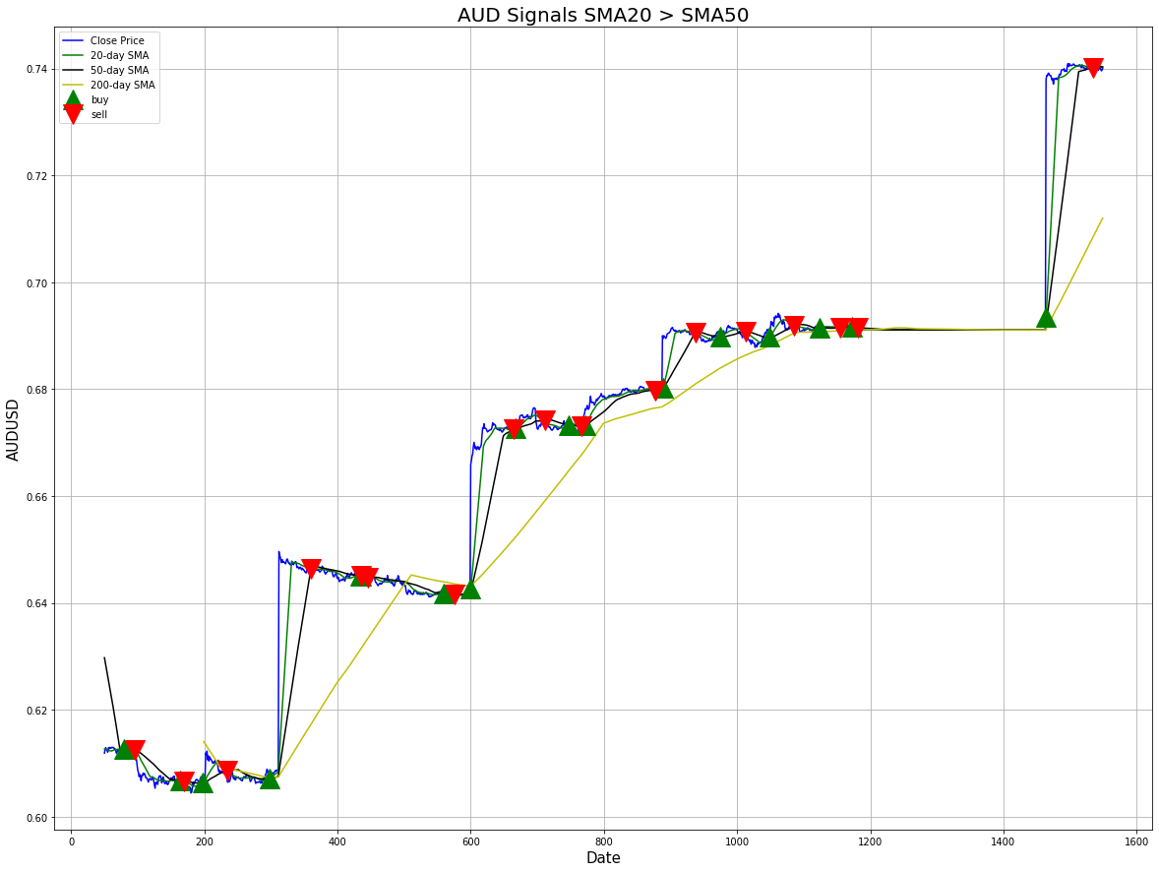
SMA20 follows the price action while SMA50 and SMA200 are relatively more lagged.
Strategy seems to work well to some extent and one can use it for trading decisions
For longer term trading can use SMA50 > or < SMA200. This is a technical chart pattern called the Golden/Death cross indicating the potential for a major rally or sell-off.
Buy signal generated SMA20 > SMA50
SMA20 and SMA50 cross upwards above SMA200, signalling bigger trend

Slide 10

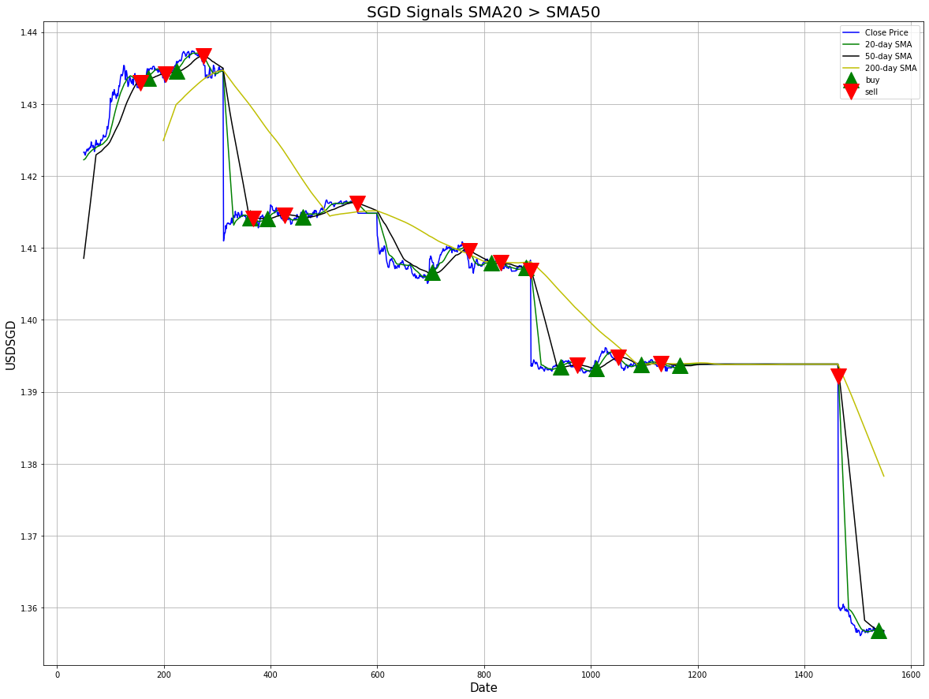
Sell signal generated SMA20 < SMA50
SMA20 and SMA50 cross down on SMA200, signalling bigger trend

Slide 11
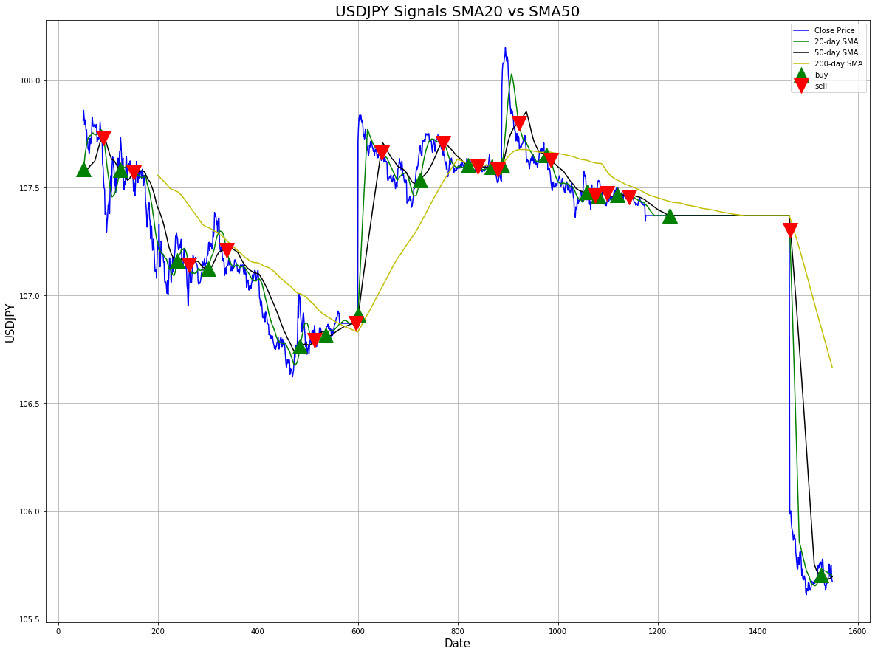
Cluster of signals here which change side rapidly can be furthered studied using tick data for HFT
Buy signal did not see much upside and changed to sell signal subsequently

Slide 12
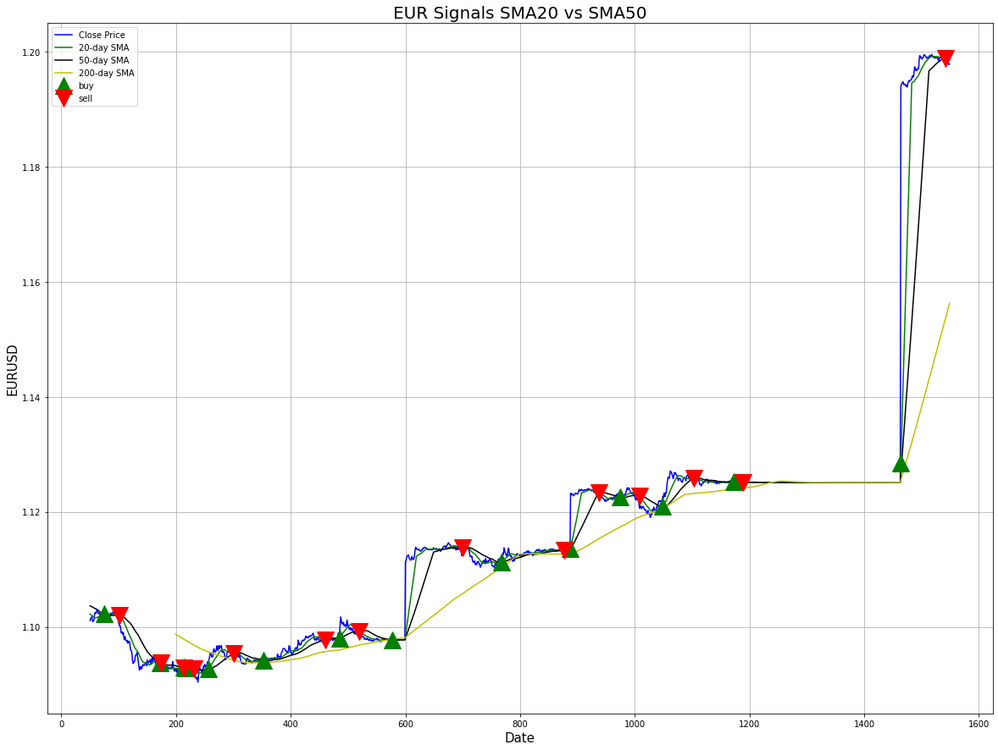
Buy signal generated just before a decent upmove In price action

Slide 13
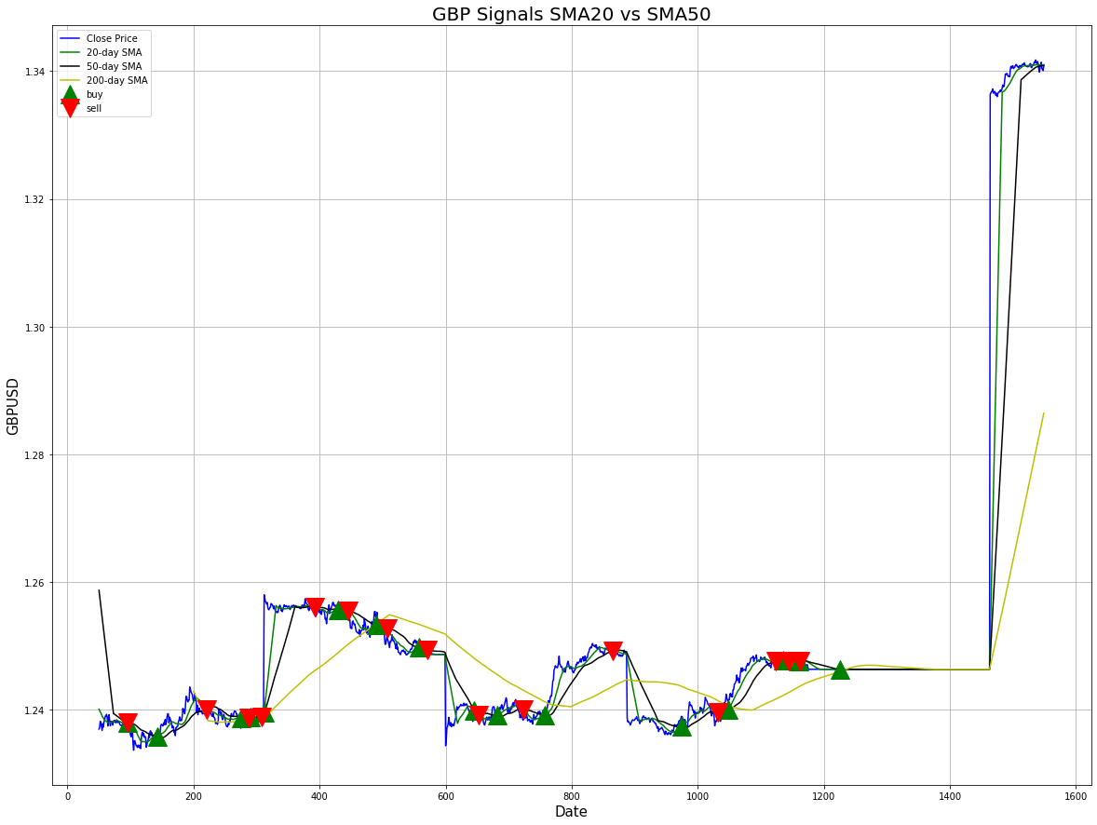
Cluster of signals here which change side rapidly can be furthered studied using tick data for HFT

Slide 14
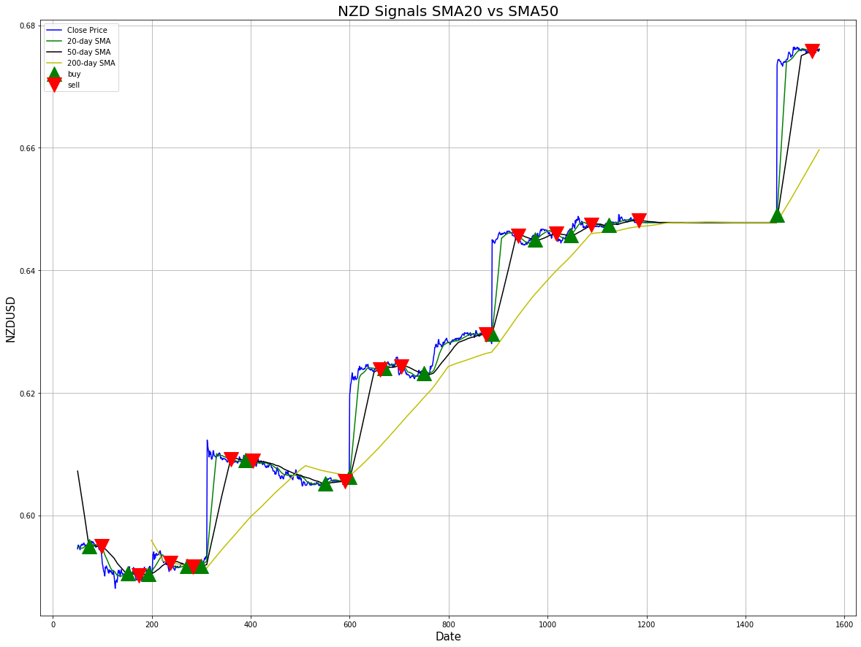
Buy signal generated SMA20 > SMA50
SMA20 and SMA50 cross upwards above SMA200, signalling bigger trend
Cluster of buy and sell signals could indicate that market is range bound and indecisive for now. Price action is flat for a while as well.

Slide 15
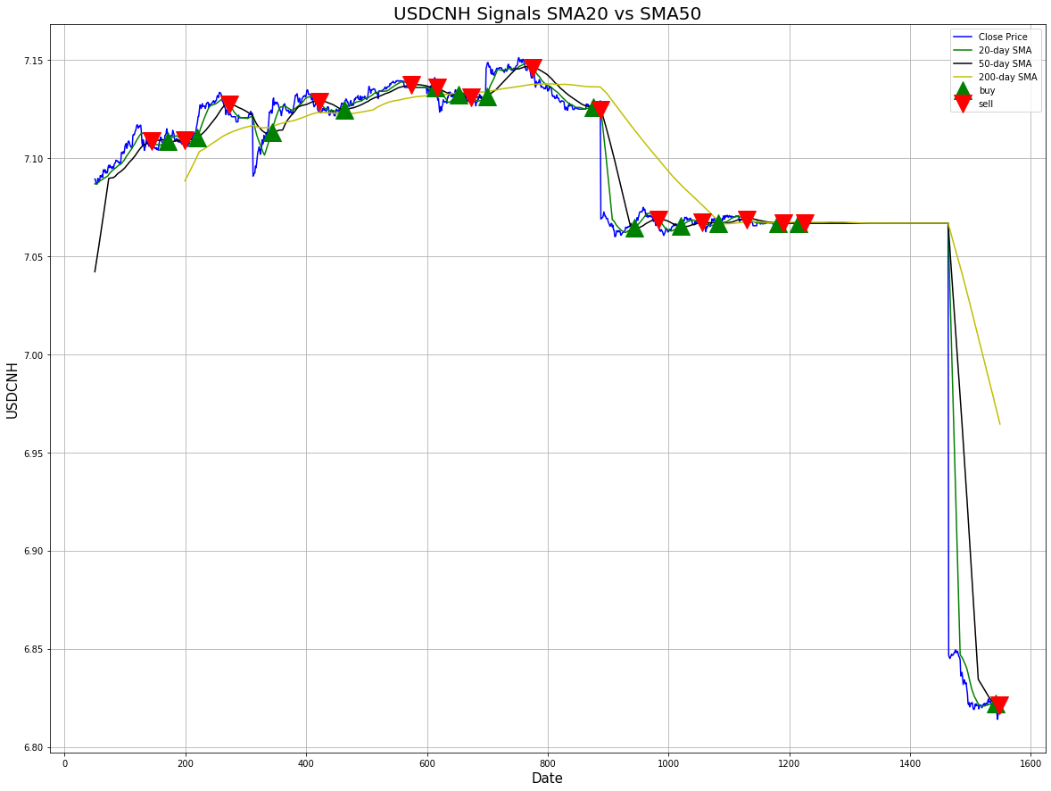
Signals coming very close together. Can analyse further using tick data fore more precision for high frequency trading

Slide 16
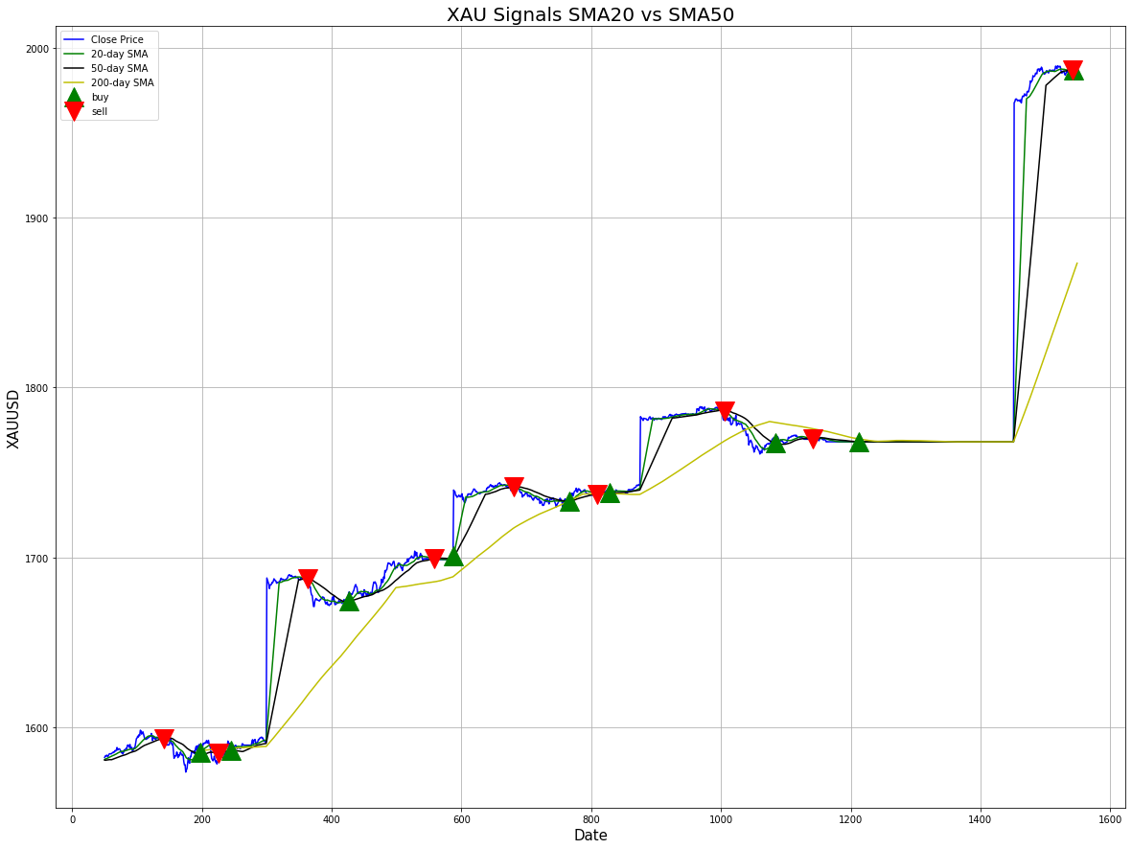
Number of signals compared to the other pairs is less
This looks like a more trendy pair to trade

Slide 17
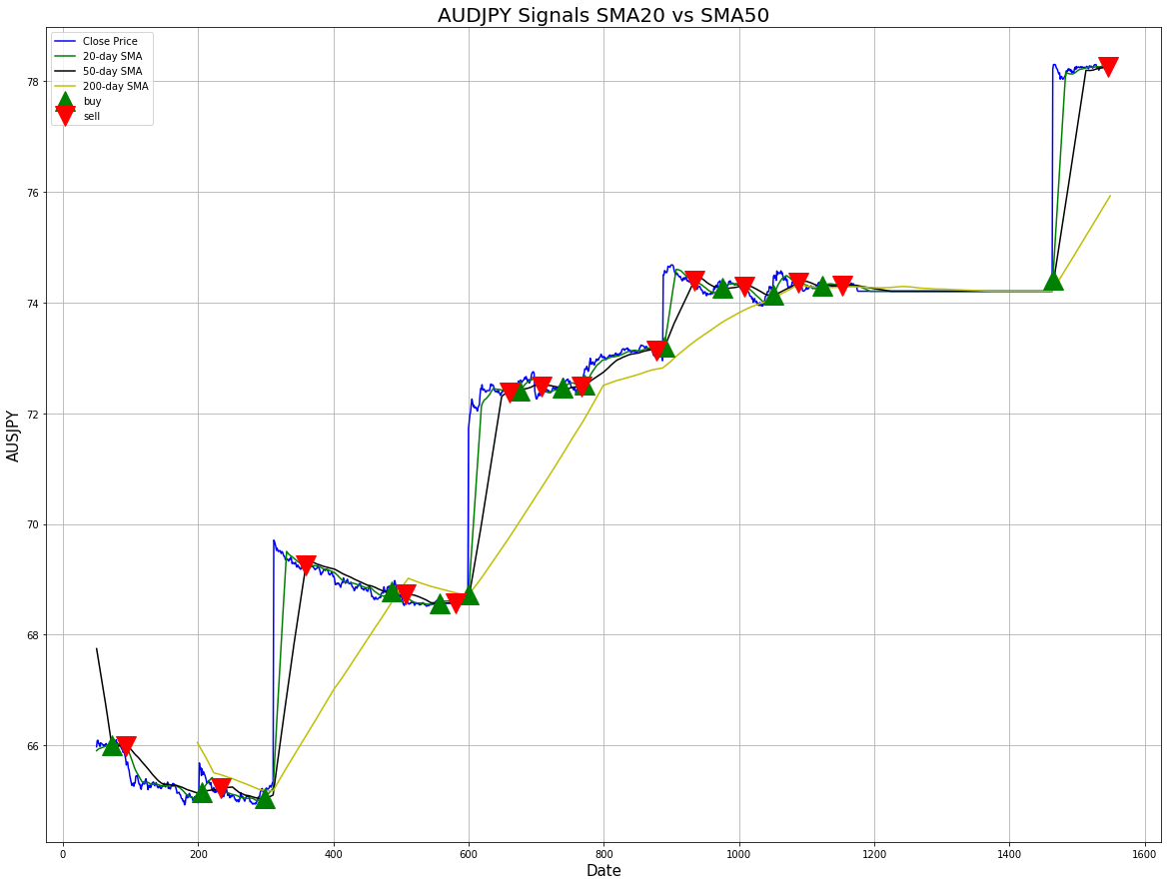
Cluster of buy and sell signals here can be furthered studied using tick data for HFT
Decent buy signals generated before a surge in price action upwards

Slide 18
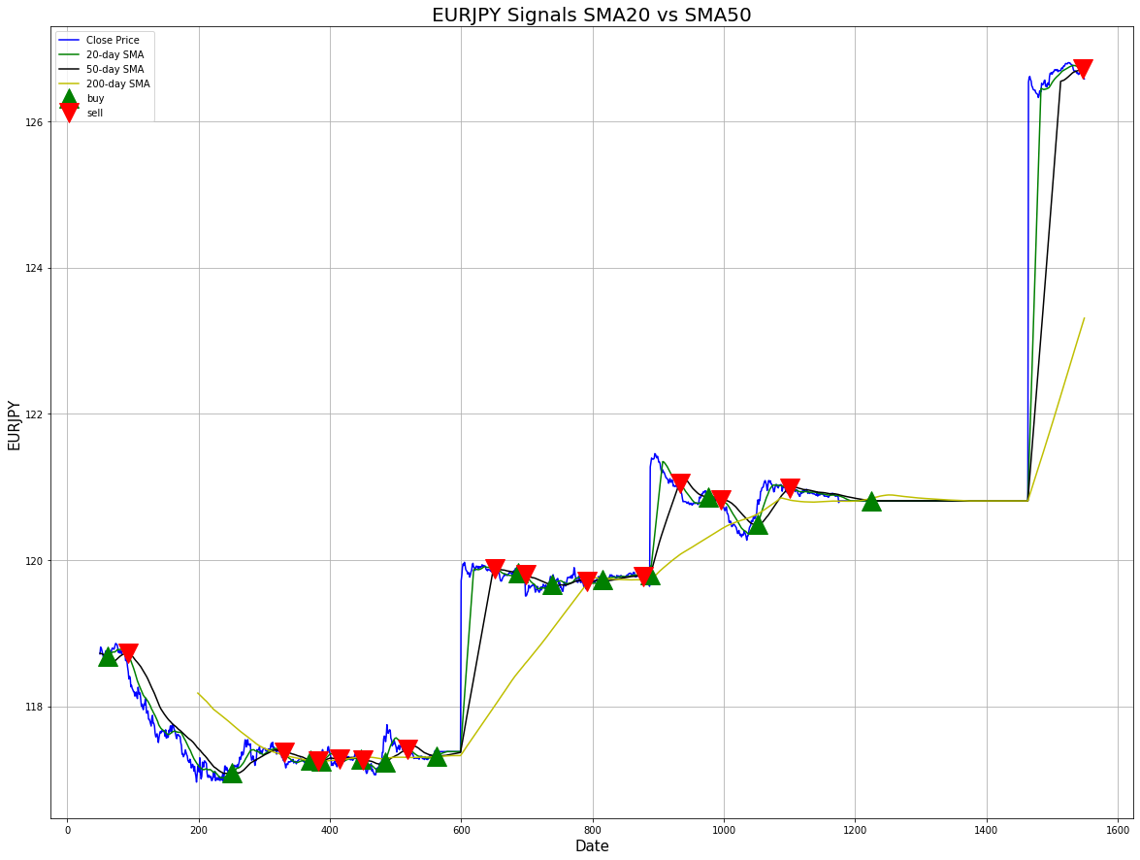
Cluster of signals here which change side rapidly can be furthered studied using tick data for HFT
Buy signal here taking some time to play out
Decent buy signal followed by a small upmove, after a clustering of signals

Slide 19
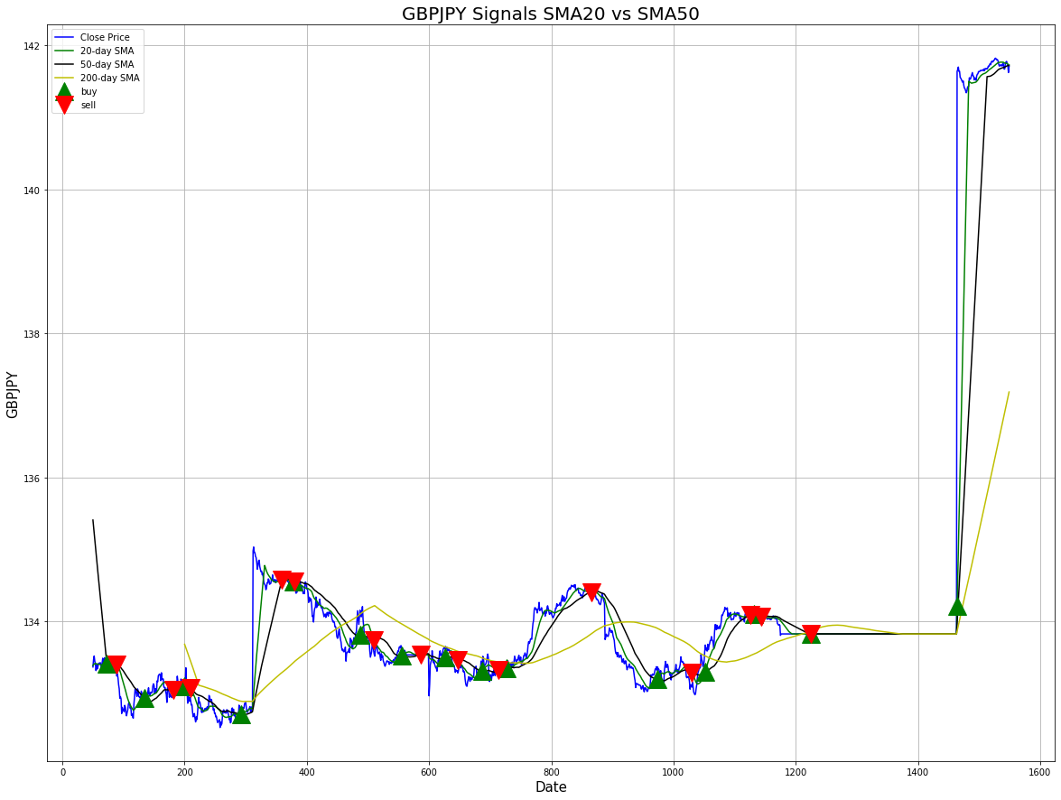
Good buy signal followed by a sharp surge in price action as the lower periods MA cut into the SMA200
Cluster of signals here which change side rapidly can be furthered studied using tick data for HFT

Slide 20

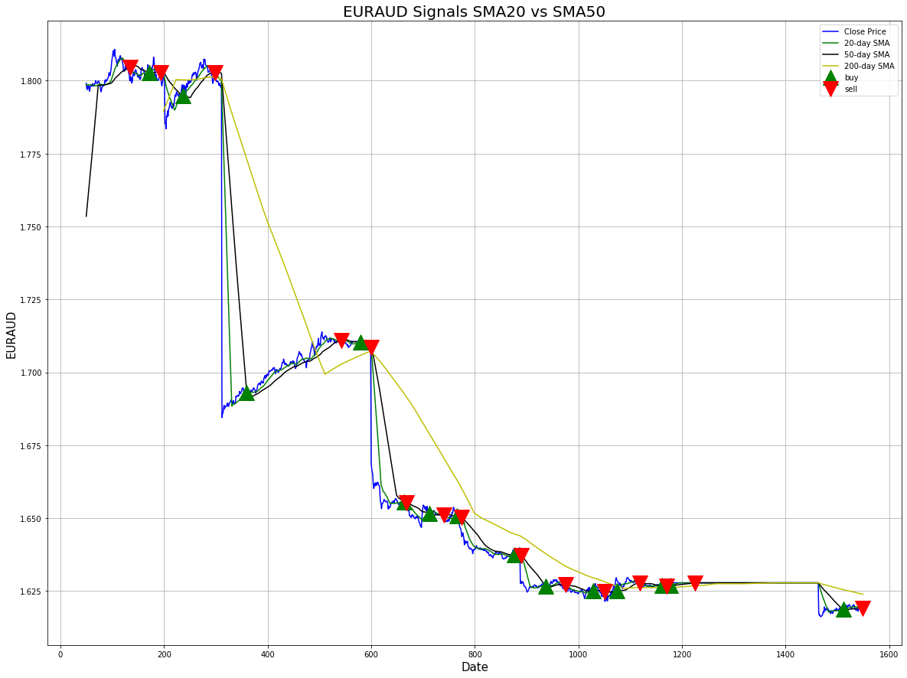
Very nice sell signal followed by a trend move as SMA20 and SMA50 cut down into the SMA200
Cluster of signals here coming close and changing side rapidly, can be furthered studied using tick data for HFT. Market seems indecisive and in a range given the many buy and sell signals generated here

Slide 21
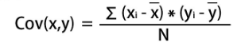
COVARIANCE and CORRELATION
In the next part of the analysis, we want to look at covariance and correlations of the straight usd pairs of our currency datasets. We will calculate covariance using Numpy and correlation using Seaborn
Covariance is a measure to indicate the extent to which two random variables change in tandem.
Correlation is a measure used to represent how strongly two random variables are related to each other. It measures both the strength and direction of the linear relationship between two variables.
COVARIANCE
Covariance only measures how two variables change together, not the dependency of one variable on another one.
Covariance indicates the direction of the linear relationship between variables.
Covariance can vary between -∞ and +∞. Covariance is affected by the change in scale.
The value of covariance between 2 variables is achieved by taking the summation of the product of the differences from the means of the variables as follows:

Slide 22
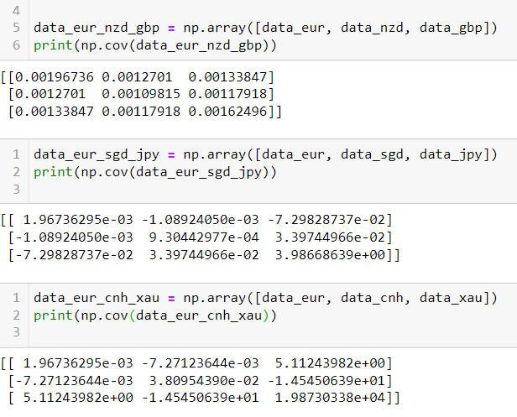
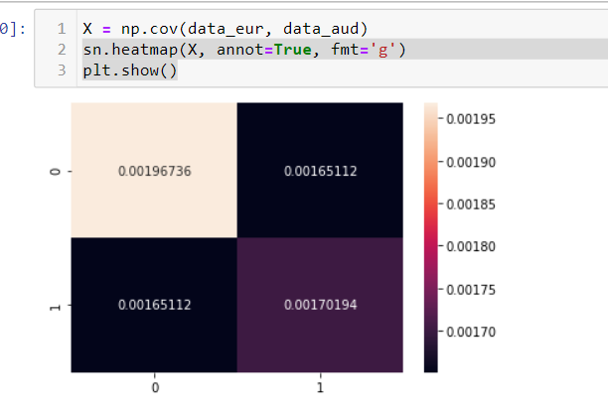
Covariance Analysis -EUR
Conclusion:
EUR with AUD, NZD, GBP or XAU have positive covariance and tend to move together
EUR with JPY, CNH, SGD have negative covariance and tend to move in opposite direction

Slide 23
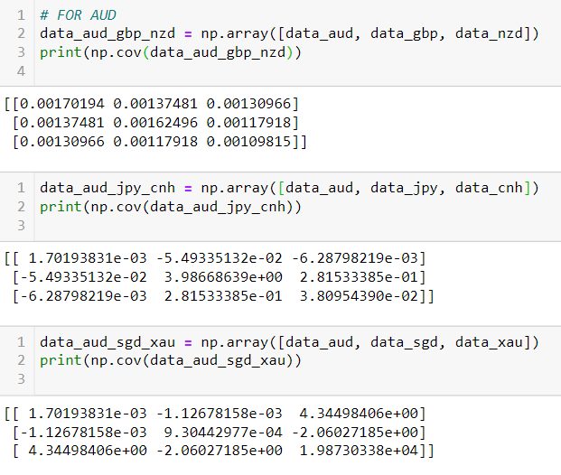
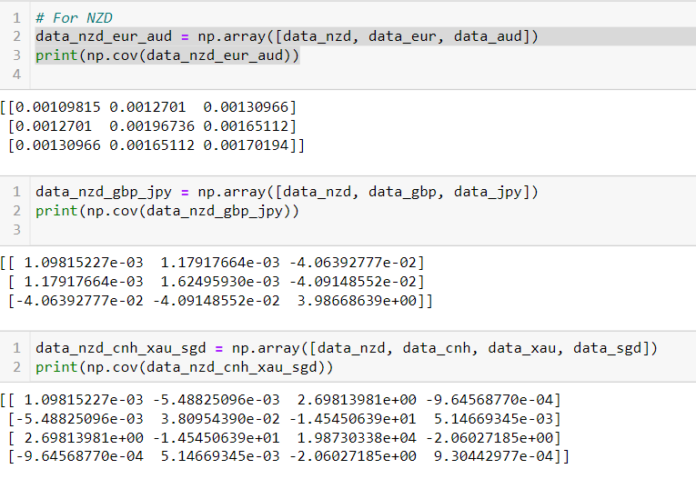
Covariance Analysis – AUD and NZD
Conclusion:
AUD with EUR, NZD, GBP or XAU have positive covariance and tend to move together
AUD with JPY, CNH, SGD have negative covariance and tend to move in opposite direction
Conclusion:
NZD with AUD, EUR, GBP or XAU have positive covariance and tend to move together
NZD with JPY, CNH, SGD have negative covariance and tend to move in opposite direction

Slide 24
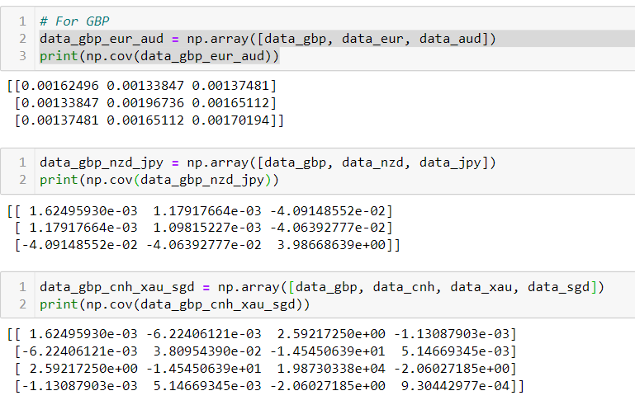
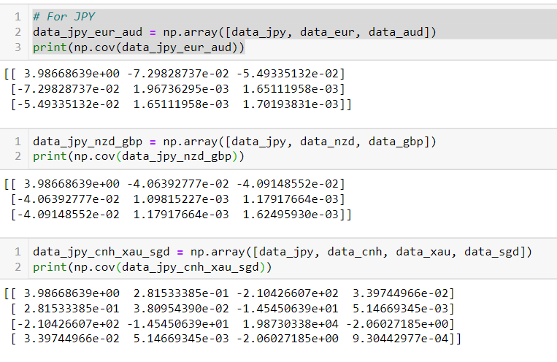
Covariance Analysis – GBP and JPY
Conclusion:
GBP with EUR, NZD, AUD or XAU have positive covariance and tend to move together
GBP with JPY, CNH, SGD have negative covariance and tend to move in opposite direction
Conclusion:
JPY with AUD, EUR, GBP or XAU negative covariance and tend to move in opposite direction
JPY with CNH, SGD have positive covariance and tend to move together

Slide 25
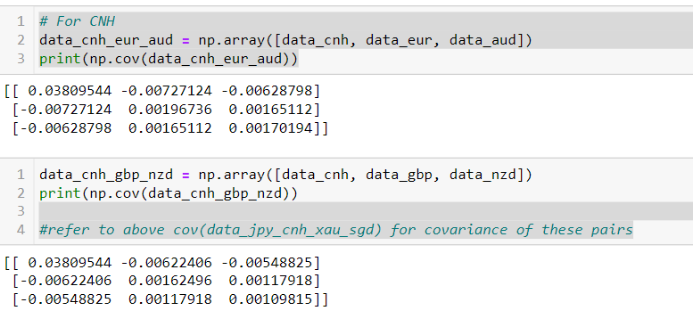
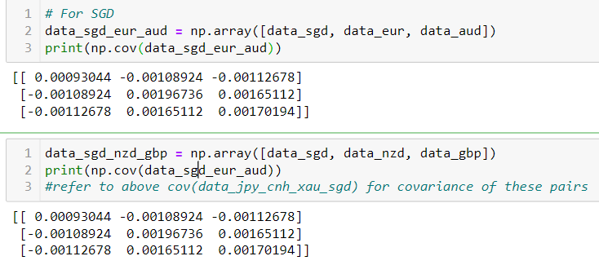
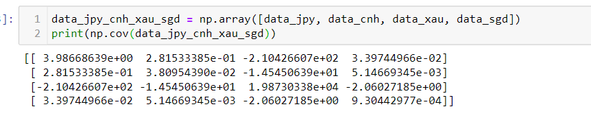
Covariance Analysis – CNH and SGD
CNH with EUR, AUD, NZD, GBP or XAU have negative covariance and tend to move in opposite direction
CNH with JPY, SGD have positive covariance and tend to move together
SGD with EUR, AUD, NZD, GBP or XAU have negative covariance and tend to move in opposite direction
SGD with JPY, CNH have positive covariance and tend to move together

Slide 26
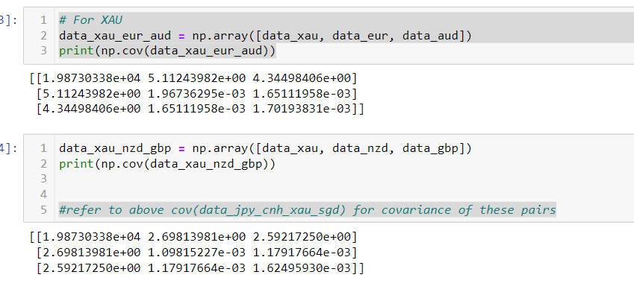
Covariance Analysis – XAU
Conclusion:
XAU with EUR, NZD, AUD or GBP have positive covariance and tend to move together
XAU with JPY, CNH, SGD have negative covariance and tend to move in opposite direction

Slide 27
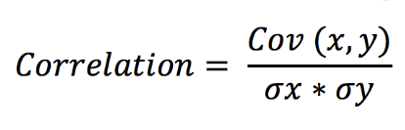
CORRELATION
Strength: The greater the absolute value of the correlation coefficient, the stronger the relationship.
The extreme values of -1 and 1 indicate a perfectly linear relationship
A coefficient of zero represents no linear relationship.
When the value is in-between 0 and +1/-1, there is some relationship, but the points don’t all fall on a line. As the correlation coefficient nears -1 or 1, the strength of the relationship increases.
Direction:
The sign of the correlation coefficient represents the direction of the relationship.
Positive coefficients indicate that when the value of one variable increases, the value of the other variable also tends to increase.
Negative coefficients represent cases when the value of one variable increases, the value of the other variable tends to decrease.
For hedging purposes of one currency against another, we can look at with high negative correlation. For trading purposes, we tend to avoid having too many highly correlated pairs in the portfolio.

Slide 28
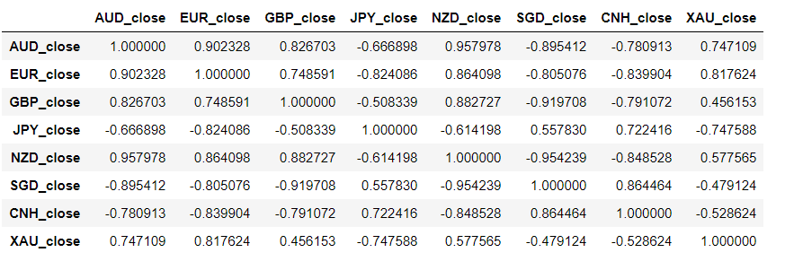
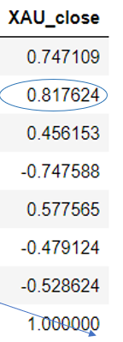
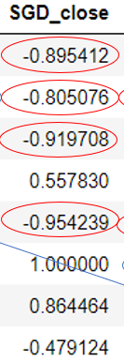
CORRELATION - Results
Blue – Positive Correlation
Red – Negative Correlation
Strong correlation defined here as absolute value > 0.80
Correlation results seem consistent with what the covariance analysis in previous slide suggested
AUD - Strong positive correlation with EUR, GBP and NZD. Fairly strong negative correlation with SGD, CNH, XAU
EUR - Strong positive correlation with AUD, NZD and XAU (gold). Strong negative correlation with JPY, SGD and CNH
GBP – Strong positive correlation with NZD. Strong negative correlation with SGD and CNH
NZD - Strong negative correlation with SGD and CNH.
SGD – Strong positive correlation with CNH.

Slide 29
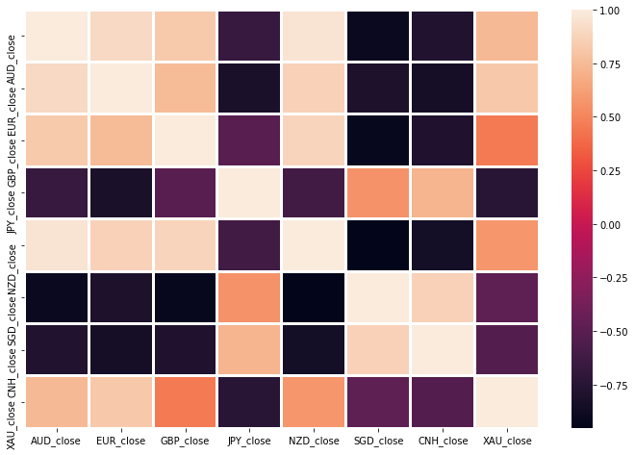
Correlation Heatmap

Slide 30
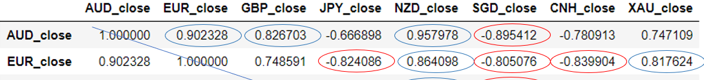
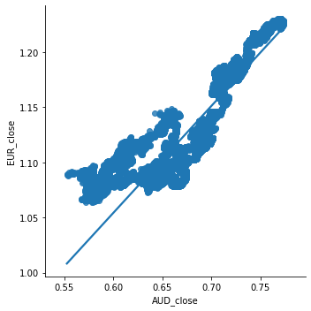
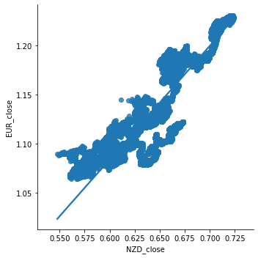
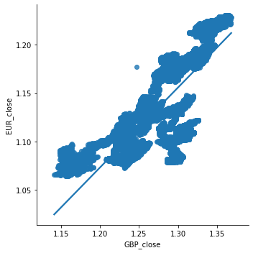
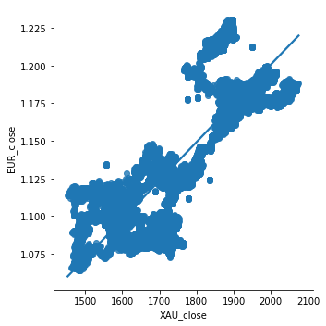
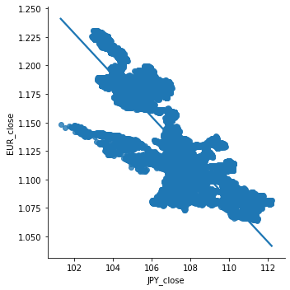
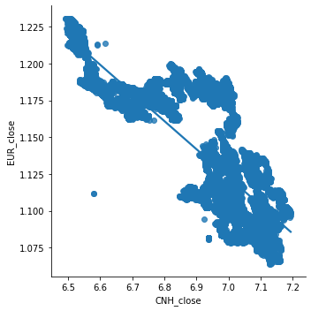
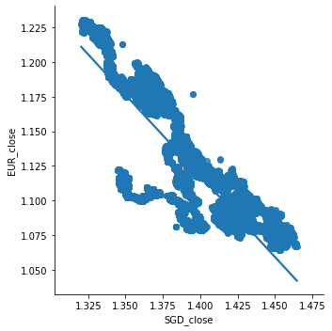
Seaborn Linear Regression
EURUSD
EUR has strong positive correlation with AUD, NZD and XAU > 0.8
EUR has strong negative correlation with JPY, CNH, SGD
The best fit lines seem to be AUD and NZD

Slide 31
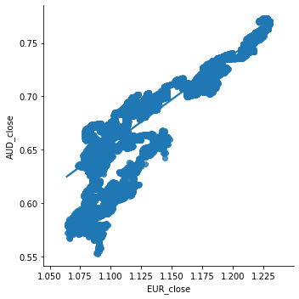
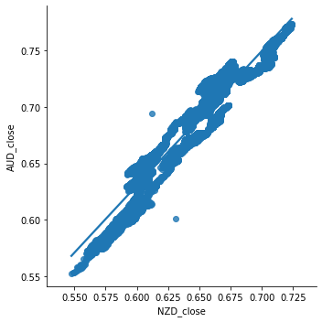
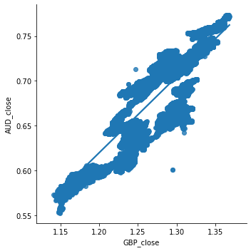
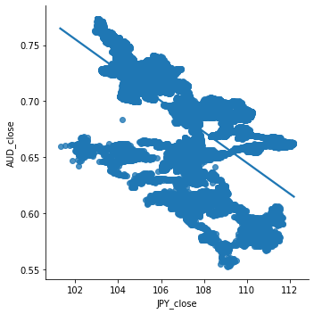
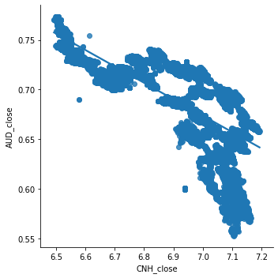
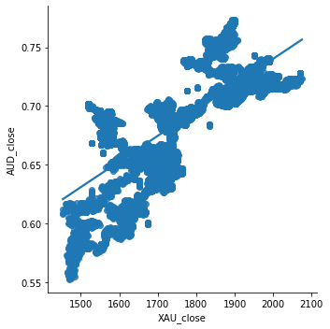
Seaborn Linear Regression
AUDUSD
AUD has strong positive correlation with EUR, NZD and GBP
AUD has strong negative correlation with SGD
The best fit lines seem to be GBP and SGD

Slide 32
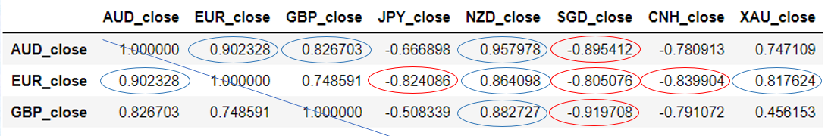
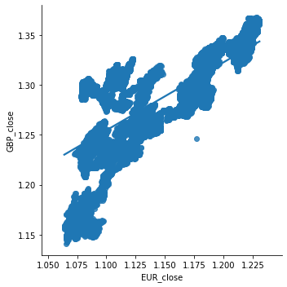






Seaborn Linear Regression
GBPUSD
GBP has strong positive correlation with NZD and AUD (>0.8)
GBP has strong negative correlation with SGD and CNH
The best fit lines seem to be NZD and SGD

Slide 33








Seaborn Linear Regression
NZDUSD
NZD has strong positive correlation with AUD, EUR, GBP
NZD has strong negative correlation with CNH, SGD
The best fit lines seem to be AUD, SGD, GBP

Slide 34








Seaborn Linear Regression
USDJPY
JPY does not exhibit any strong positive correlation with any pair greater than 0.8
JPY has strong negative correlation with EUR
The regression fit is not that ideal and the best fit line does seem to be EUR and perhaps CNH

Slide 35
Seaborn Linear Regression
USDCNH
CNH has strong positive correlation with SGD
CNH has fairly strong negative correlation with NZD, GBP, AUD and EUR >0.75
The best fit lines seem to be AUD, GBP and SGD

Slide 36








Seaborn Linear Regression
XAUUSD
XAU has strong positive correlation with EUR and a fairly strong correlation with AUD. XAU has no strong negative correlation to any pairs > 0,8
The best fit lines seem to be EUR and AUD. Relatively bad fit in CNH SGD and GBP.

Slide 37








SGD has strong negative correlation with EUR, AUD, GBP and NZD.
SGD has strong positive correlation with CNH. Most of these countries are also our top trading partners.
The best fit lines seem to be AUD, NZD and GBP. Relatively poor fit for XAU and JPY
Seaborn Linear Regression
USDSGD

Slide 38


Correlation: USDSGD Application
Singapore’s monetary policy, is managed through the use of a floating exchange rate tool. The Singapore dollar is managed against a basket of currencies of our major trading partners. The MAS operates a managed float regime for the Singapore dollar with the trade-weighted exchange rate allowed to fluctuate within a policy band.
MAS does not publicly release the policy parameters, for example, currencies in the S$NEER basket, weights of each currency, policy band width, appreciation gradient and midpoint of the policy band.
We can use the correlation analysis and Singapore’s total trade data to
determine the top trading partners, and then carry out hypothesis testing or OLS Regression to build your own NEERS$ model.

Slide 39



IS ARBITRAGE PRESENT?
Goal:
To find out if there is basis for arbitrage of our 4 pairs of crosses (AUDJPY, EURJPY, GBPJPY, EURAUD) versus the product of their straight usd component pairs (eg AUDJPY_implied)
Arbitrage opportunities are present from the results of this analysis.
Loosely speaking, based on the mean and 50% percentile, the strategy is to:
a) Buy AUDJPY_implied and sell AUDJPY cross
b) Buy EURJPY_implied and sell EURJPY cross
c) Buy GBPJPY_implied and sell GBPJPY cross
d) Sell EURAUD_implied and buy EURAUD cross
However, in the real world, for high frequency trading, tick data and a connection to live data feeds and execution platforms are necessary to maximise the profit from these opportunities.

Slide 40
Conclusion
The type of indicators and analysis depends on your purpose (trading, hedging etc) and trading style and horizon. For forex, it tends to require more short term indicators relative to equities or bonds, given the nature of the market
In this study, the focus was on short term trading on the SMA strategy using SMA20 and SMA50. Some currency pairs had more consistent signals and results than others. There was also further potential for finer data to be analysed for more profitable HFT strategies
There are many other strategies not covered in this study. Some use RSI, MACD vs price divergence etc. At the end of the day, we must identify which indicator works best for which pair by backtesting the results
There are also limitations to this study:
Data set is 5 mins data instead of tick data
Certain indicators may not perform consistently eg correlation and trend following models have failed in past few years
Some areas for further analysis includes:
Find a way to crunch years of heavy tick data for machine learning models
Explore live data feeds, check different trading strategies and backtest the results
Formulate a HFT model, to take advantage of arbitrage or market latency when price gets volatile and automate the execution.

Slide 41

Visit me at:
https://github.com/Ste11a-star/FX-Analysis

